Slide 1
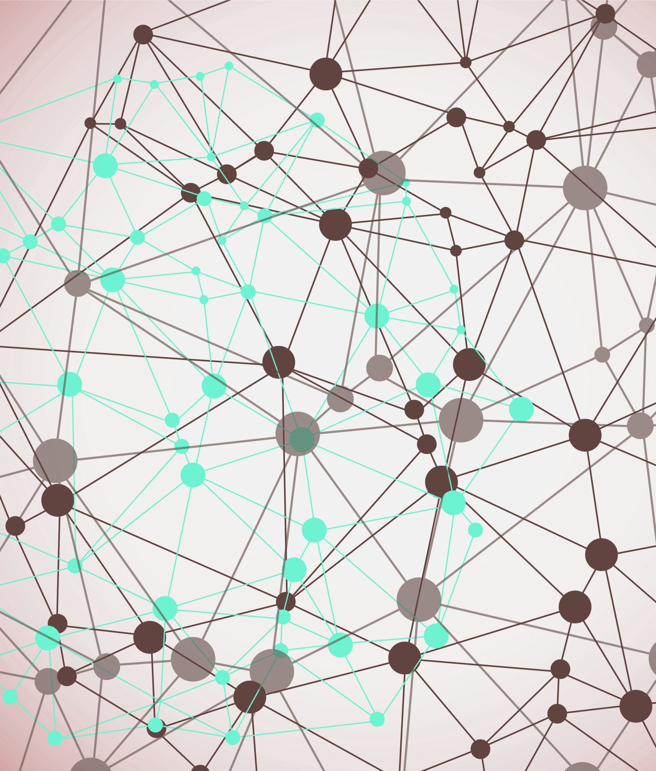
Improving sentiment analysis through use of image and audio data
ST311 Group 11

Slide 2
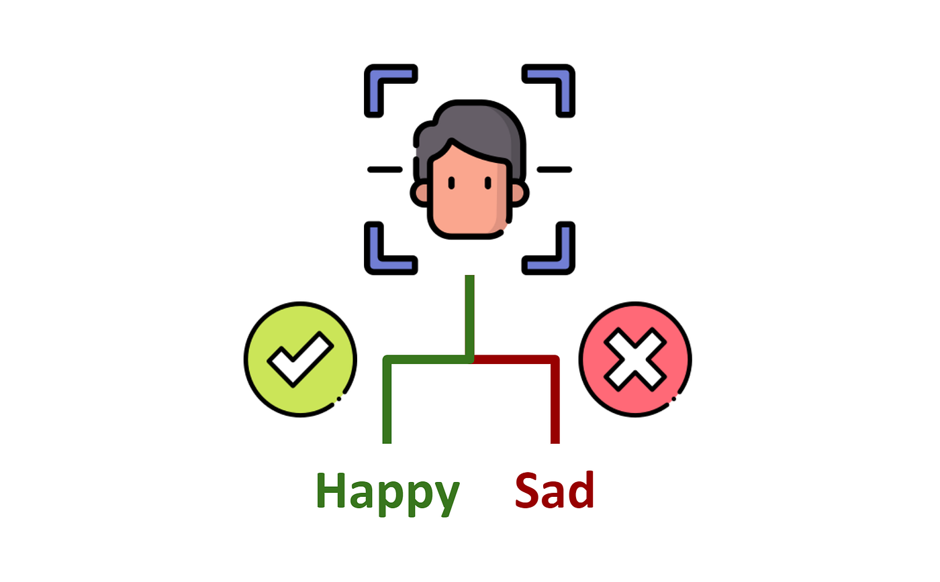

What our project is about:
Can computers interpret emotions like humans?
If it just takes in one part of an input (the content of a speech for example)- then no- we humans process facial emotions and vocal signals as well to make judgements on emotion
We combine 4 AI-models that are good at the respective tasks of extracting emotions through imagery, voice, and text into 1 super-model to make a well-rounded judgement

Slide 3
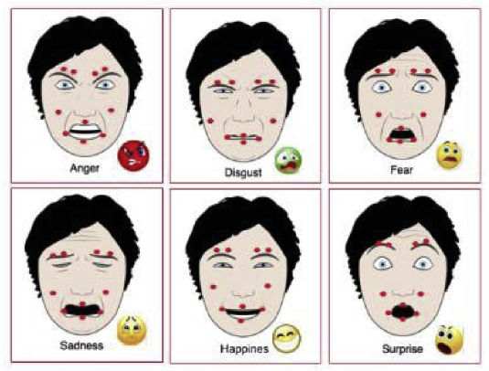
Why this is important
Current gap exists in computer emotional extraction, which is mostly limited to a single source (e.g. facial-emotional recognition)
This limits the usage of AI-applications for sources that contain emotional signals from a broad range of modes (e.g. video clips/real life situations)
This project fills the gap to conduct emotional-detection for visual + audio sources

Slide 4
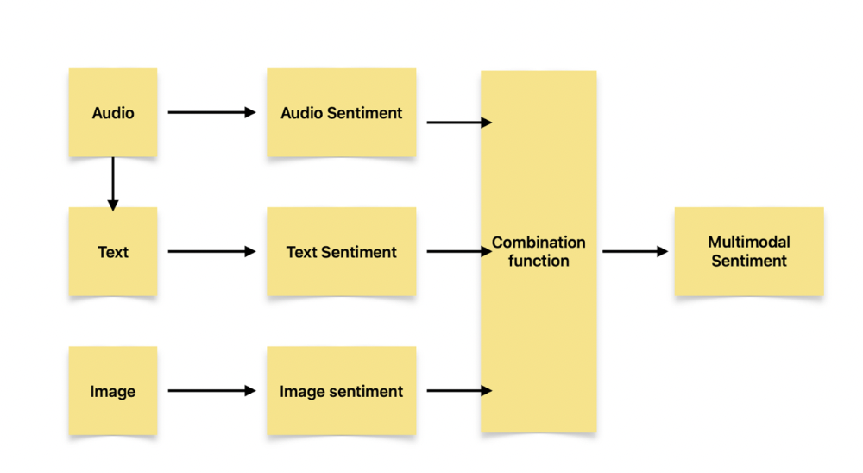
Broad overview
Our model fuses the three different ones together with our bespoke ‘combination function’ (we just made up the weights based on vibes)

Slide 5
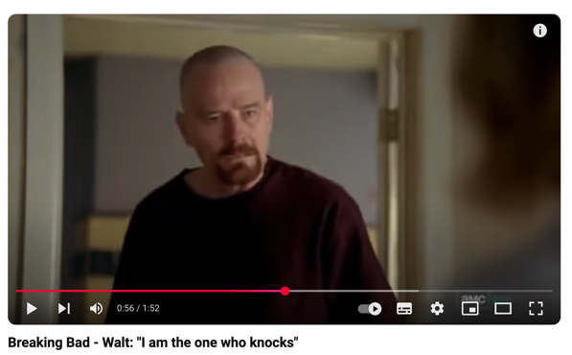
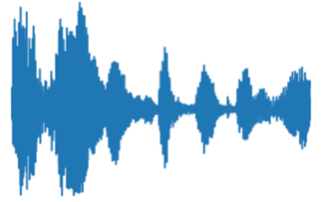

How our model works example (Part 1)
An audio file (.wav) of the emotional speech
An image representing facial expression is passed through a CNN trained to recognise facial expression
The text of the speech is detected via the Whispers model and passed into RoBERTa
The emotion of the speech is detected by the Wav2Vec2

Slide 6
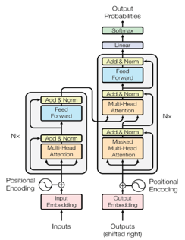
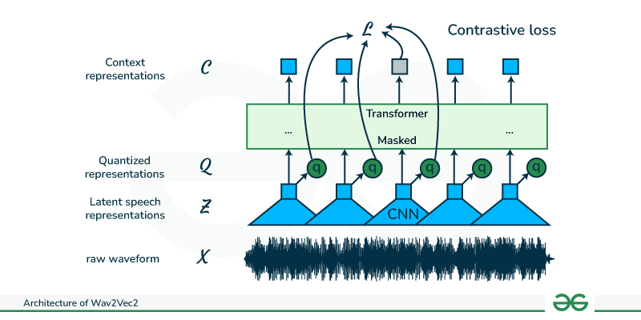
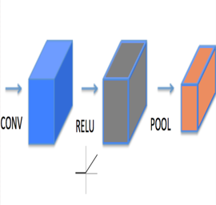
How our model works (Part 2)
The text of the speech is detected via the Whispers model and passed into RoBERTa
The Wav2Vec model finds sentiment of audio
Output: A SoftMax detailing the emotion intensity picked up by the network
{‘Anger’: 0.9, ‘Disgust’ 0.05,…]
The text sentiment analysis output is also a SoftMax score [‘Anger’: 0.4, ‘Disgust’: 0.3,…]
This model also outputs a SoftMax
The three sentiment analysis scores are combined to create the final SoftMax output. This is done via a weighting algorithm.

Slide 7
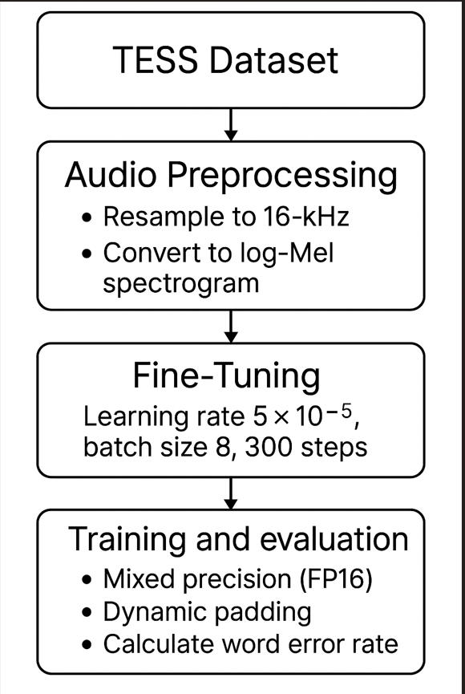
Model 1a: Audio-Text Translation
We used the Whisper model by OpenAi as our base model.
Trained on the Toronto Emotional Speech Set, this data contains one word audio files. The word is said in different type of emotions.
Whisper is trained on long audio (e.g., podcasts), so we decided to train on short audio to make it better at transcribing shorter audio.
The training follows the step as shown in the image. However, because we fine tuned the model in short audio clips, it became worse at transcribing longer audio. Therefore, we decided to stick to the original Whisper Model for our final model.
The output text is fed into RoBERTa, the text sentiment model.
Our goal from this training is to make Whisper better at transcribing more emotion rich audio, so that this can possibility extended to applications like therapy chat bot for example.

Slide 8
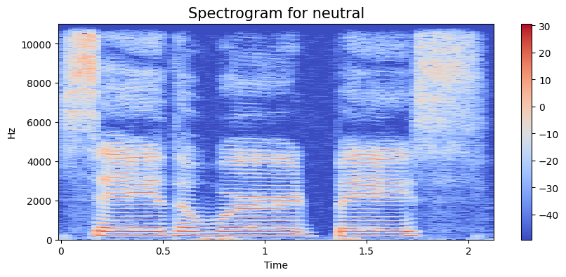
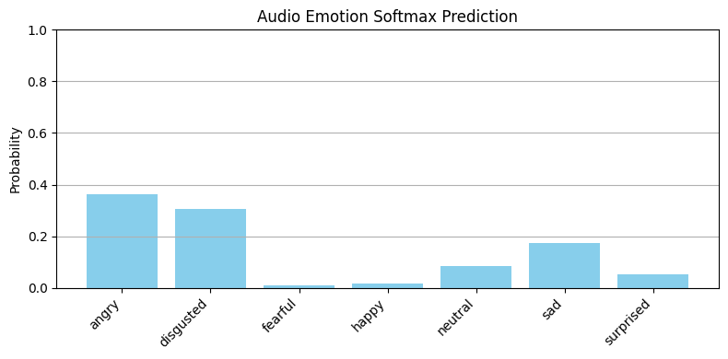
Model 2: Voice Emotion Extraction
Training
Usage
The Wav2Vec2 pre-trained by Facebook utilises the CTC model to recognise audio emotions
We fine-tune the model with labelled audio clips in the Toronto Emotional Speech Set, before arriving at an accuracy rate of 99.6%
Feed in the sample audio clip to generate logits for emotional predictions and to pass to Softmax

Slide 9
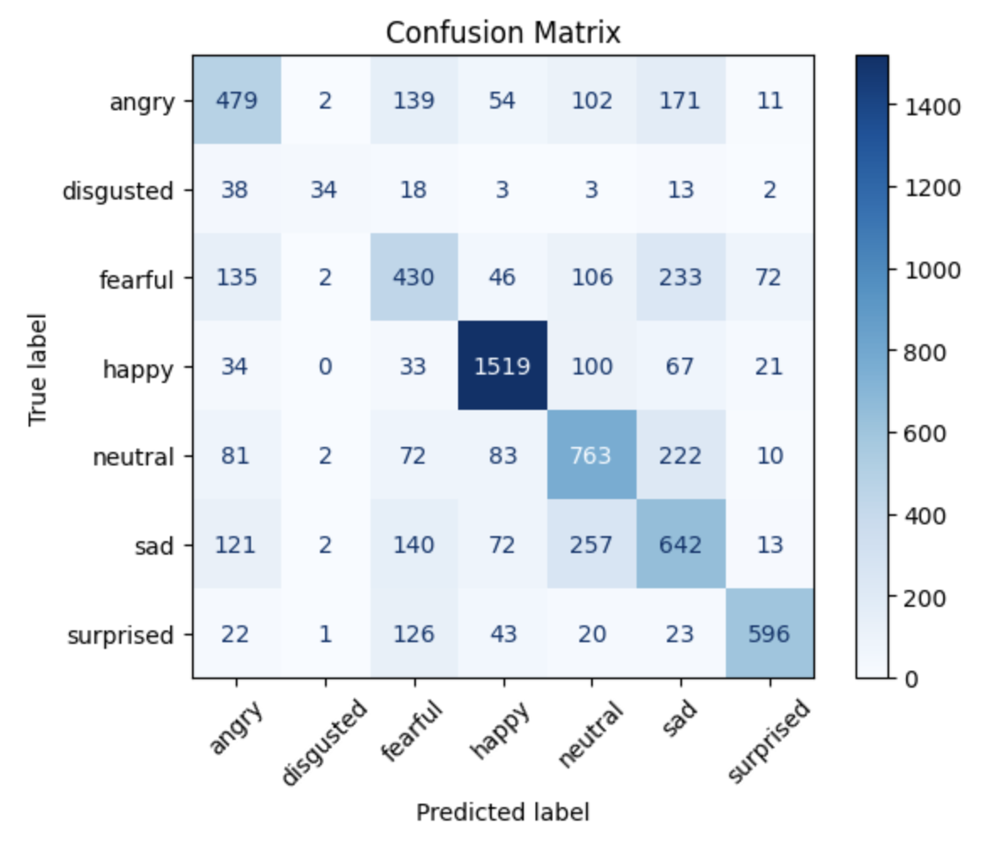
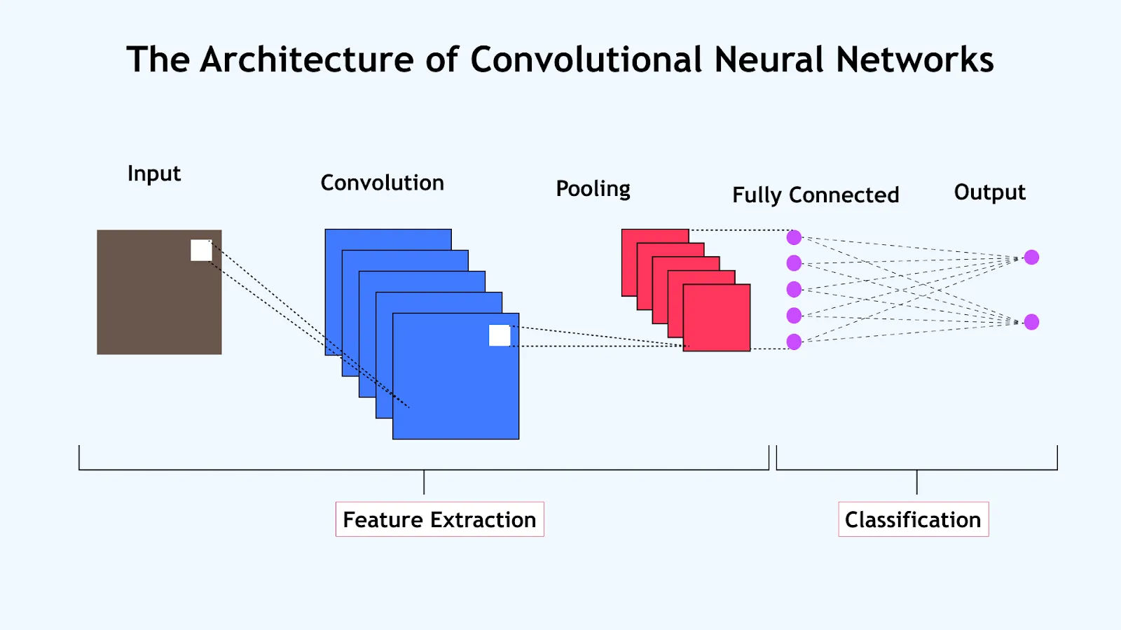
Model 3: Image Emotion Extraction
What we built:
A Convolutional Neural Network (CNN) trained to spot emotions in grayscale images of faces.
The model was trained on a dataset of labelled facial expressions (FER-2013).
How it works:
Takes a 48×48 image of a person’s face.
Detects patterns like smiles or frowns.
Predicts the most likely emotion (e.g., happy, angry, sad).
Why it matters:
Facial expressions can reveal emotion even when words or tone are unclear.
This gives our overall system a visual understanding of how someone feels.

Slide 10
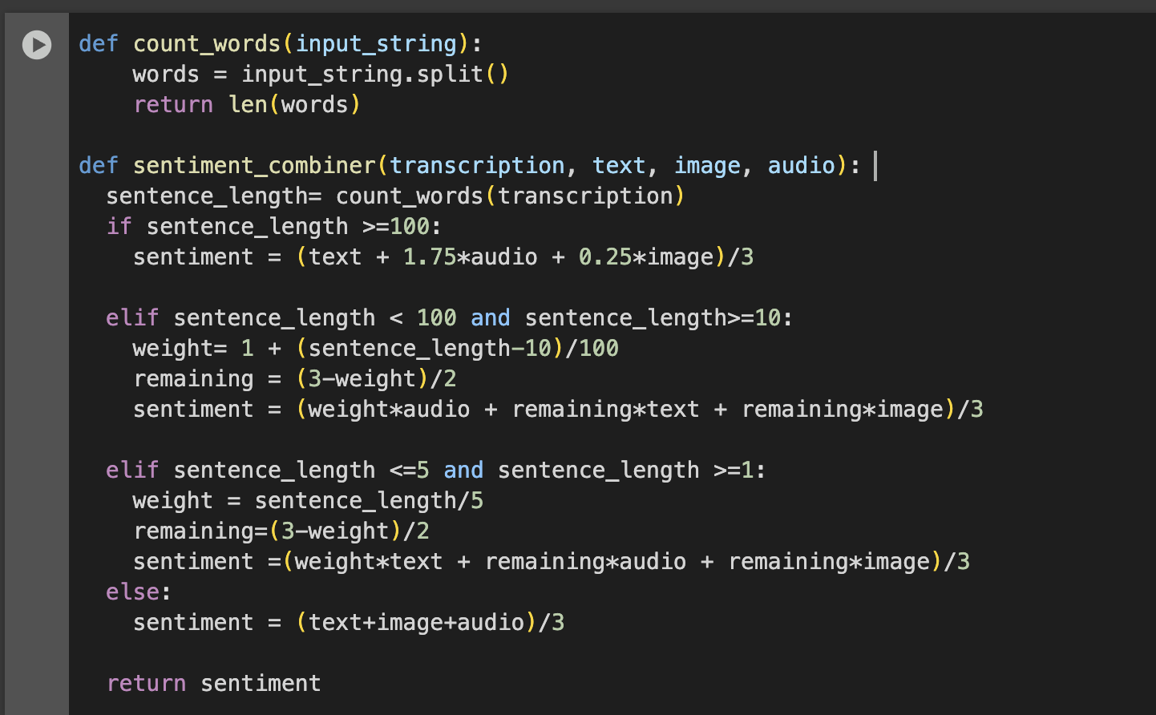
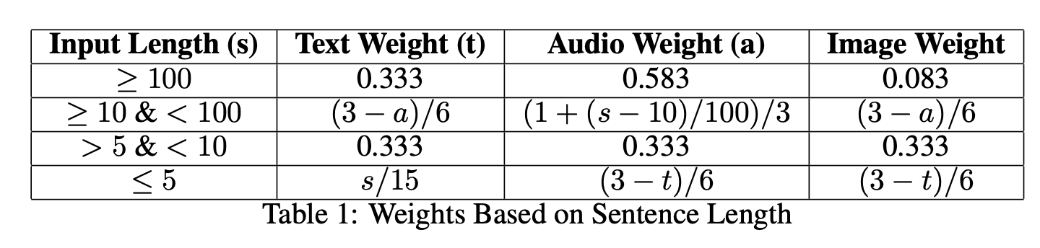
Combination: Tie in model outputs

Slide 11




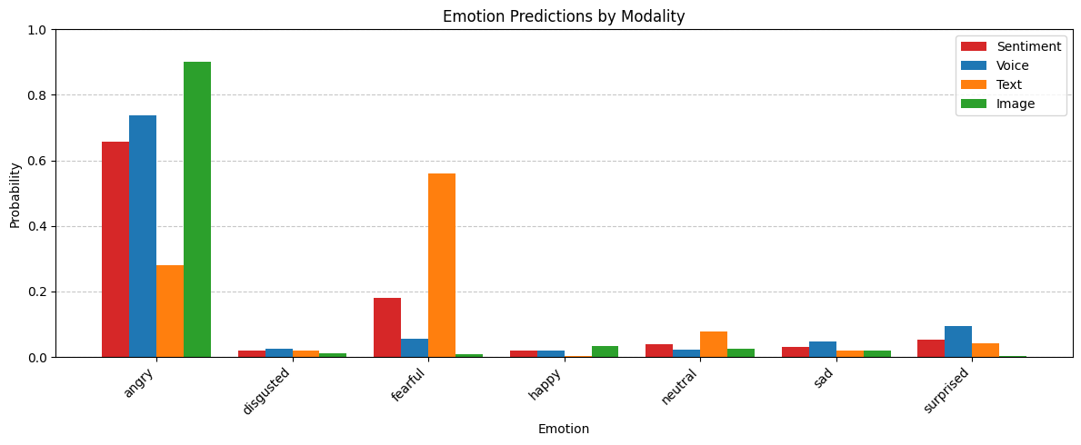
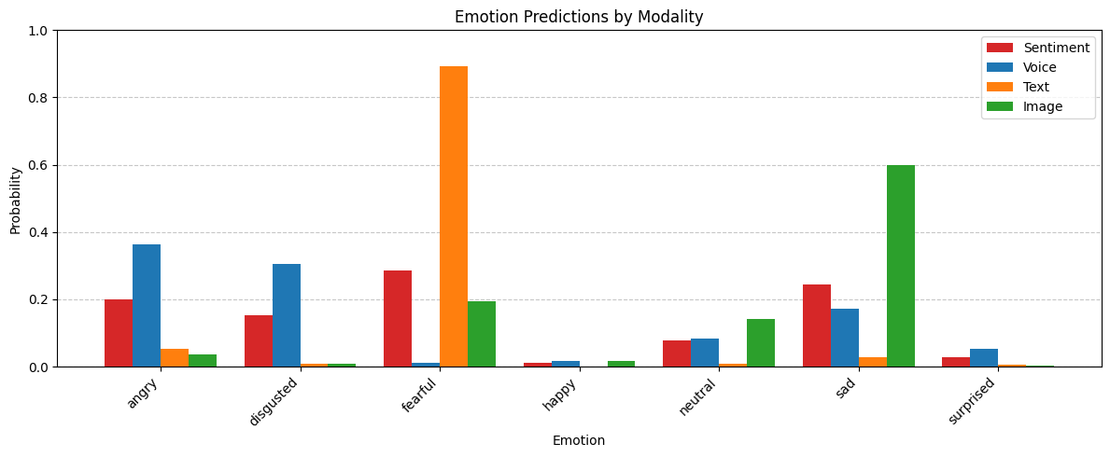
Real World Experiment: Model In Action

Slide 12
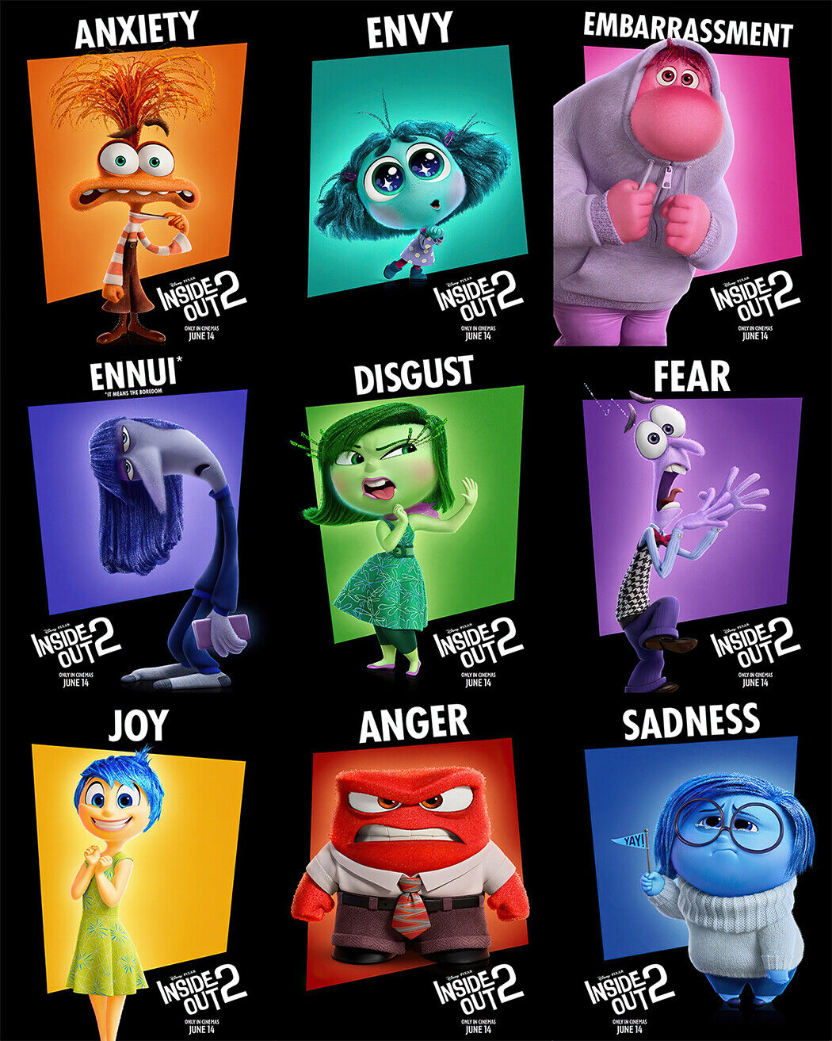
Limitations and extensions
Out late fusion method we implement is a manual fusion, where we manually combine the 3 outputs we get from image, audio and text. However, int academia, there exists many other ways to combine these 3 outputs by using a more sophisticated strategy, such as building another model (neural network) that can learn to combine the model in way to optimise performance.
In our work, we only use the main 6 type of emotion and added "neutral" to have 7. However, human emotion is more complex in the real world. There are emotions we have not covered in our project; future research can dive deeper into sentimental analysis with more variety and complexity of emotions.

Slide 13
Thank you for listening (reading)!

